Slide 1
The extended Euclidean algorithm lets us find modular multiplicative inverses
INSERT
VIDEO
HERE

Slide 2
The extended Euclidean algorithm lets us find modular multiplicative inverses
What the extended Euclidean algorithm tells us
INSERT
VIDEO
HERE

Slide 3
The extended Euclidean algorithm lets us find modular multiplicative inverses
What the extended Euclidean algorithm tells us
A lightweight version of the EAA
INSERT
VIDEO
HERE

Slide 4
The extended Euclidean algorithm lets us find modular multiplicative inverses
What the extended Euclidean algorithm tells us
A lightweight version of the EAA
Examples when the multiplicative inverse exists
INSERT
VIDEO
HERE

Slide 5
The extended Euclidean algorithm lets us find modular multiplicative inverses
What the extended Euclidean algorithm tells us
A lightweight version of the EAA
Examples when the multiplicative inverse exists
An examples when it doesn’t
INSERT
VIDEO
HERE

Slide 6
The extended Euclidean algorithm is information overkill
INSERT
VIDEO
HERE

Slide 7
The extended Euclidean algorithm is information overkill
Given x and y, finds integers a and b such that
INSERT
VIDEO
HERE

Slide 8

The extended Euclidean algorithm is information overkill
Given x and y, finds integers a and b such that
$$ax+by=gcd\left(x,y\right)$$
INSERT
VIDEO
HERE

Slide 9
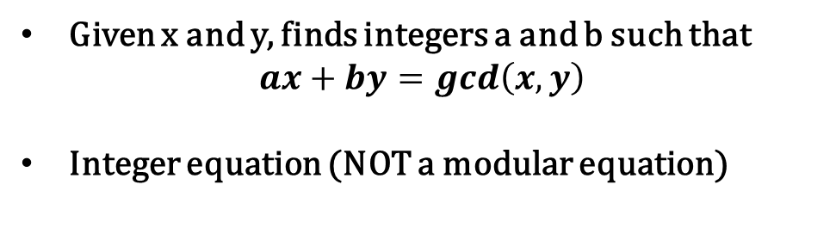
The extended Euclidean algorithm is information overkill
Given x and y, finds integers a and b such that
$$ax+by=gcd\left(x,y\right)$$
Integer equation (NOT a modular equation)
INSERT
VIDEO
HERE

Slide 10
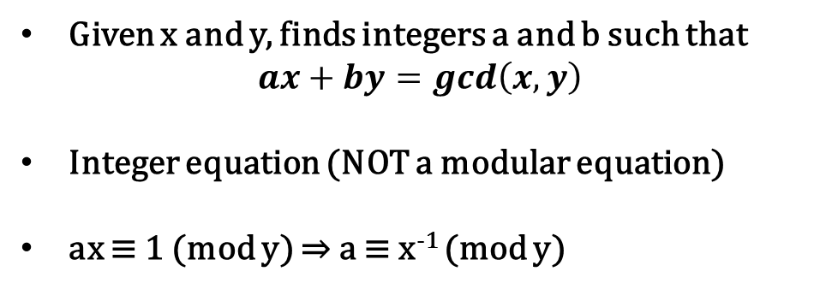
The extended Euclidean algorithm is information overkill
Given x and y, finds integers a and b such that
$$ax+by=gcd\left(x,y\right)$$
Integer equation (NOT a modular equation)
ax ≡ 1 (mod y) ⇒ a ≡ x⁻¹ (mod y)
INSERT
VIDEO
HERE

Slide 11
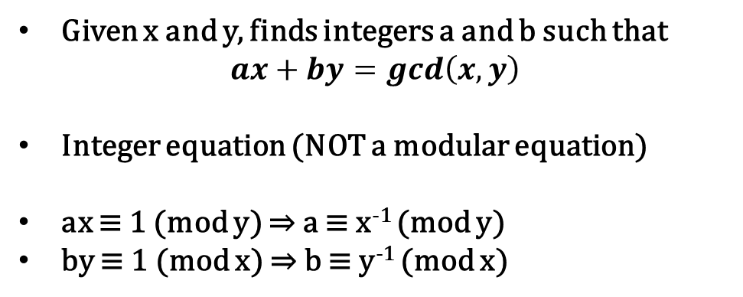
The extended Euclidean algorithm is information overkill
Given x and y, finds integers a and b such that
$$ax+by=gcd\left(x,y\right)$$
Integer equation (NOT a modular equation)
ax ≡ 1 (mod y) ⇒ a ≡ x⁻¹ (mod y)
by ≡ 1 (mod x) ⇒ b ≡ y⁻¹ (mod x)
INSERT
VIDEO
HERE

Slide 12
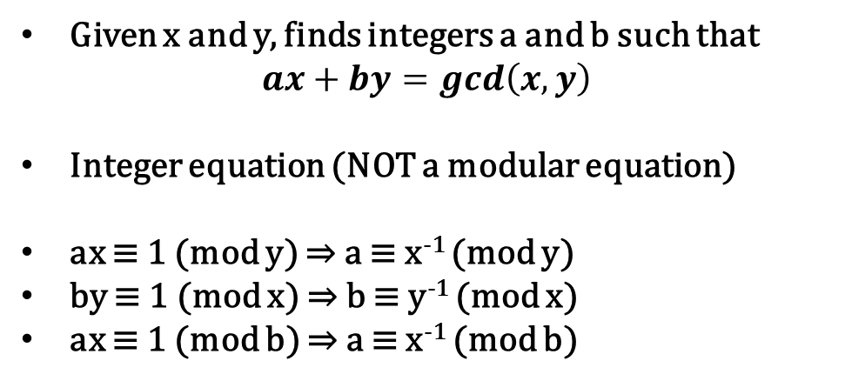
The extended Euclidean algorithm is information overkill
Given x and y, finds integers a and b such that
$$ax+by=gcd\left(x,y\right)$$
Integer equation (NOT a modular equation)
ax ≡ 1 (mod y) ⇒ a ≡ x⁻¹ (mod y)
by ≡ 1 (mod x) ⇒ b ≡ y⁻¹ (mod x)
ax ≡ 1 (mod b) ⇒ a ≡ x⁻¹ (mod b)
INSERT
VIDEO
HERE

Slide 13
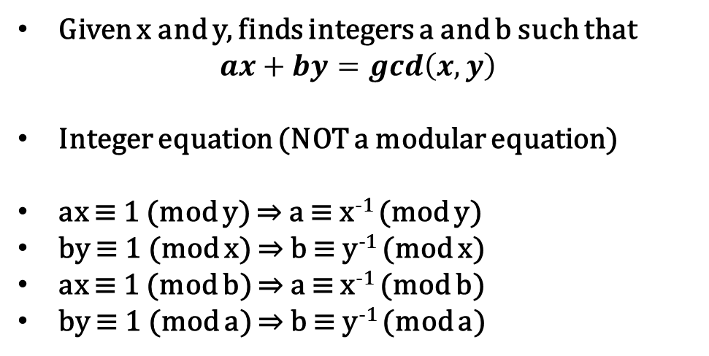
The extended Euclidean algorithm is information overkill
Given x and y, finds integers a and b such that
$$ax+by=gcd\left(x,y\right)$$
Integer equation (NOT a modular equation)
ax ≡ 1 (mod y) ⇒ a ≡ x⁻¹ (mod y)
by ≡ 1 (mod x) ⇒ b ≡ y⁻¹ (mod x)
ax ≡ 1 (mod b) ⇒ a ≡ x⁻¹ (mod b)
by ≡ 1 (mod a) ⇒ b ≡ y⁻¹ (mod a)
INSERT
VIDEO
HERE

Slide 14
The extended Euclidean algorithm may not yield a solution – which is good!
INSERT
VIDEO
HERE

Slide 15

The extended Euclidean algorithm may not yield a solution – which is good!
$$ax+by=1$$
INSERT
VIDEO
HERE

Slide 16

The extended Euclidean algorithm may not yield a solution – which is good!
$$ax+by=1$$
Possibly many, none, or one solution
INSERT
VIDEO
HERE

Slide 17
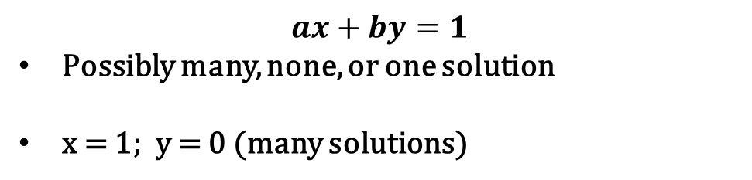
The extended Euclidean algorithm may not yield a solution – which is good!
$$ax+by=1$$
Possibly many, none, or one solution
x = 1; y = 0 (many solutions)
INSERT
VIDEO
HERE

Slide 18
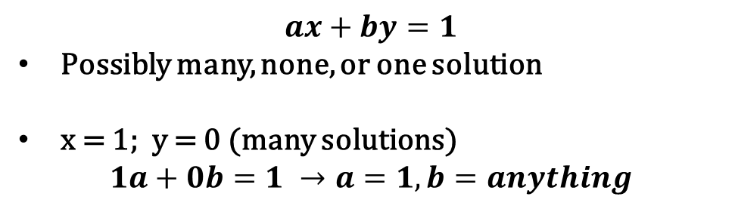
The extended Euclidean algorithm may not yield a solution – which is good!
$$ax+by=1$$
Possibly many, none, or one solution
x = 1; y = 0 (many solutions)
$$1a+0b=1 →a=1, b=anything$$
INSERT
VIDEO
HERE

Slide 19
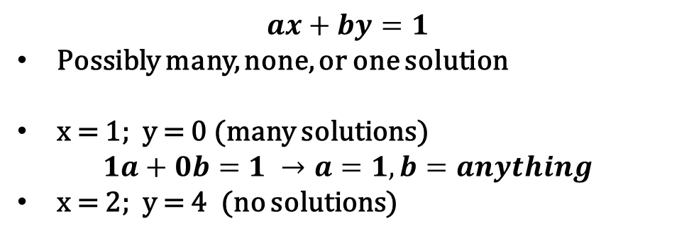
The extended Euclidean algorithm may not yield a solution – which is good!
$$ax+by=1$$
Possibly many, none, or one solution
x = 1; y = 0 (many solutions)
$$1a+0b=1 →a=1, b=anything$$
x = 2; y = 4 (no solutions)
INSERT
VIDEO
HERE

Slide 20
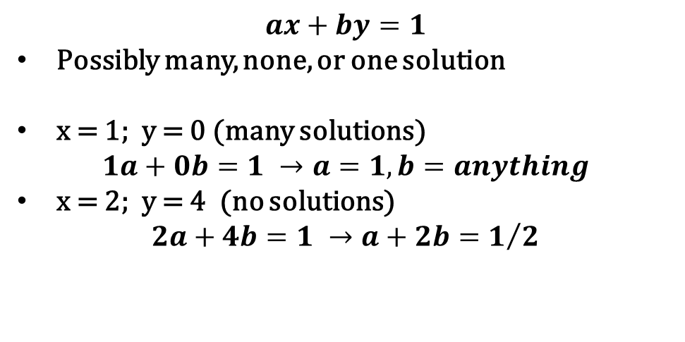
The extended Euclidean algorithm may not yield a solution – which is good!
$$ax+by=1$$
Possibly many, none, or one solution
x = 1; y = 0 (many solutions)
$$1a+0b=1 →a=1, b=anything$$
x = 2; y = 4 (no solutions)
$$2a+4b=1 →a+2b=1/2$$
INSERT
VIDEO
HERE

Slide 21
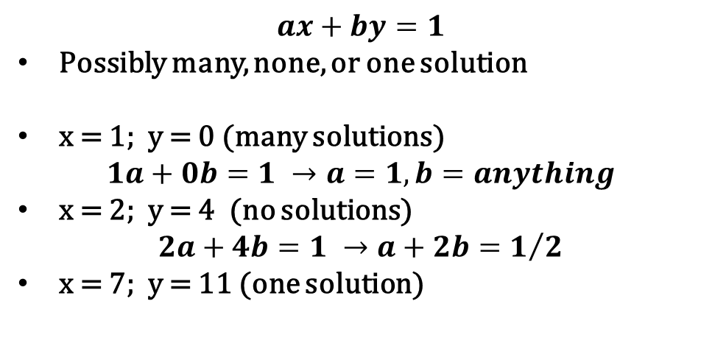
The extended Euclidean algorithm may not yield a solution – which is good!
$$ax+by=1$$
Possibly many, none, or one solution
x = 1; y = 0 (many solutions)
$$1a+0b=1 →a=1, b=anything$$
x = 2; y = 4 (no solutions)
$$2a+4b=1 →a+2b=1/2$$
x = 7; y = 11 (one solution)
INSERT
VIDEO
HERE

Slide 22
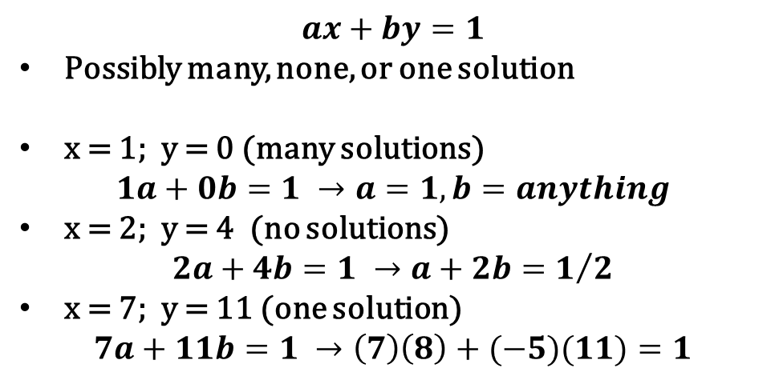
The extended Euclidean algorithm may not yield a solution – which is good!
$$ax+by=1$$
Possibly many, none, or one solution
x = 1; y = 0 (many solutions)
$$1a+0b=1 →a=1, b=anything$$
x = 2; y = 4 (no solutions)
$$2a+4b=1 →a+2b=1/2$$
x = 7; y = 11 (one solution)
$$7a+11b=1 →\left(7\right)\left(8\right)+(−5)(11)=1$$
INSERT
VIDEO
HERE

Slide 23
Expressing the Euclidean algorithm as a recurrence relation is our start
INSERT
VIDEO
HERE

Slide 24

Expressing the Euclidean algorithm as a recurrence relation is our start
$$gcd\left(m,x\right)=gcd(x, m mod x)$$
INSERT
VIDEO
HERE

Slide 25

Expressing the Euclidean algorithm as a recurrence relation is our start
$$gcd\left(m,x\right)=gcd(x, m mod x)$$
$$gcd\left(r\left[0\right], r\left[1\right]\right)=gcd\left(r\left[1\right], r\left[2\right]\right)$$
INSERT
VIDEO
HERE

Slide 26
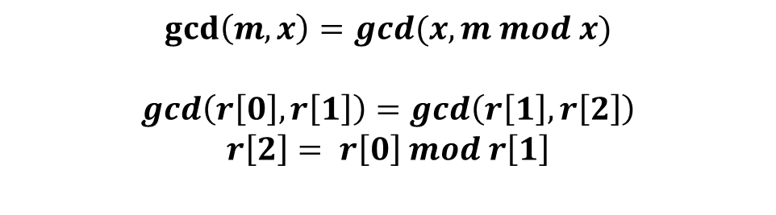
Expressing the Euclidean algorithm as a recurrence relation is our start
$$gcd\left(m,x\right)=gcd(x, m mod x)$$
$$gcd\left(r\left[0\right], r\left[1\right]\right)=gcd\left(r\left[1\right], r\left[2\right]\right)$$
$$r\left[2\right]= r\left[0\right] mod r\left[1\right]$$
INSERT
VIDEO
HERE

Slide 27
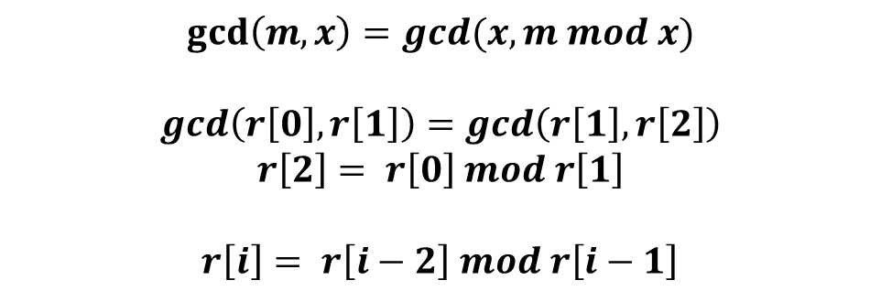
Expressing the Euclidean algorithm as a recurrence relation is our start
$$gcd\left(m,x\right)=gcd(x, m mod x)$$
$$gcd\left(r\left[0\right], r\left[1\right]\right)=gcd\left(r\left[1\right], r\left[2\right]\right)$$
$$r\left[2\right]= r\left[0\right] mod r\left[1\right]$$
$$r\left[i\right]= r\left[i−2\right] mod r\left[i−1\right]$$
INSERT
VIDEO
HERE

Slide 28
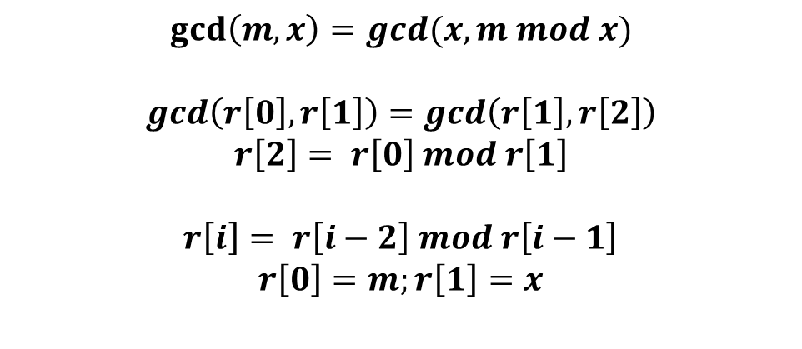
Expressing the Euclidean algorithm as a recurrence relation is our start
$$gcd\left(m,x\right)=gcd(x, m mod x)$$
$$gcd\left(r\left[0\right], r\left[1\right]\right)=gcd\left(r\left[1\right], r\left[2\right]\right)$$
$$r\left[2\right]= r\left[0\right] mod r\left[1\right]$$
$$r\left[i\right]= r\left[i−2\right] mod r\left[i−1\right]$$
$$r\left[0\right]=m;r\left[1\right]=x$$
INSERT
VIDEO
HERE

Slide 29
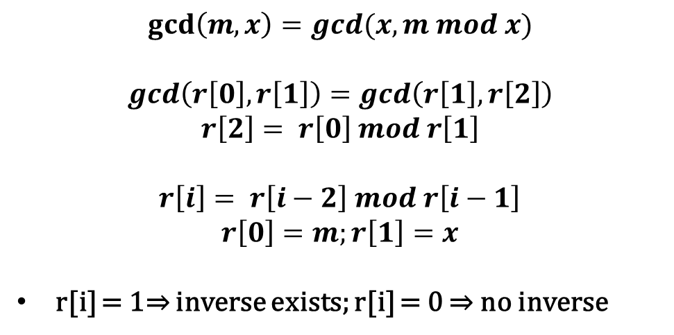
Expressing the Euclidean algorithm as a recurrence relation is our start
$$gcd\left(m,x\right)=gcd(x, m mod x)$$
$$gcd\left(r\left[0\right], r\left[1\right]\right)=gcd\left(r\left[1\right], r\left[2\right]\right)$$
$$r\left[2\right]= r\left[0\right] mod r\left[1\right]$$
$$r\left[i\right]= r\left[i−2\right] mod r\left[i−1\right]$$
$$r\left[0\right]=m;r\left[1\right]=x$$
r[i] = 1⇒ inverse exists; r[i] = 0 ⇒ no inverse
INSERT
VIDEO
HERE

Slide 30
Need to tie the multiplicative inverse to Euclidean algorithm recurrence relation
INSERT
VIDEO
HERE

Slide 31

Need to tie the multiplicative inverse to Euclidean algorithm recurrence relation
$$ax≡1 (mod m)$$
INSERT
VIDEO
HERE

Slide 32

Need to tie the multiplicative inverse to Euclidean algorithm recurrence relation
$$ax≡1 (mod m)$$
$$a[i]x≡r[i] (mod m)$$
INSERT
VIDEO
HERE

Slide 33
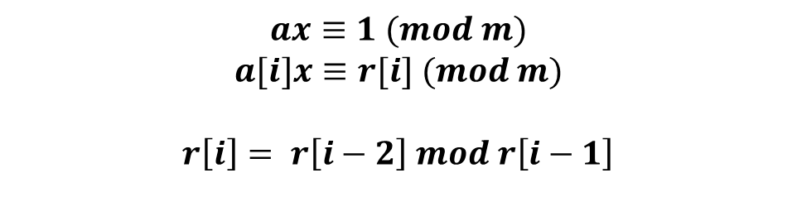
Need to tie the multiplicative inverse to Euclidean algorithm recurrence relation
$$ax≡1 (mod m)$$
$$a[i]x≡r[i] (mod m)$$
$$r\left[i\right]= r\left[i−2\right] mod r\left[i−1\right]$$
INSERT
VIDEO
HERE

Slide 34
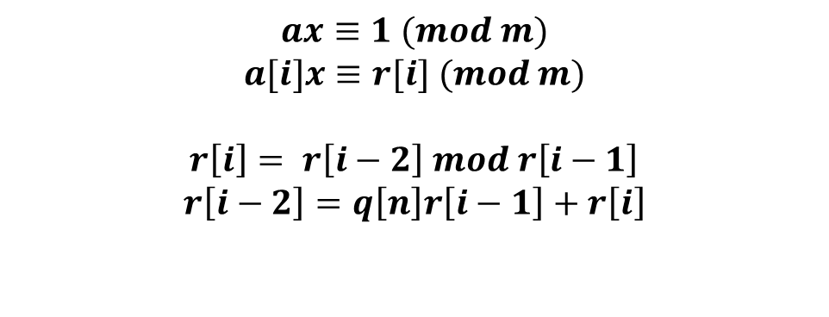
Need to tie the multiplicative inverse to Euclidean algorithm recurrence relation
$$ax≡1 (mod m)$$
$$a[i]x≡r[i] (mod m)$$
$$r\left[i\right]= r\left[i−2\right] mod r\left[i−1\right]$$
$$r\left[i−2\right]=q\left[n\right]r\left[i−1\right]+r\left[i\right]$$
INSERT
VIDEO
HERE

Slide 35
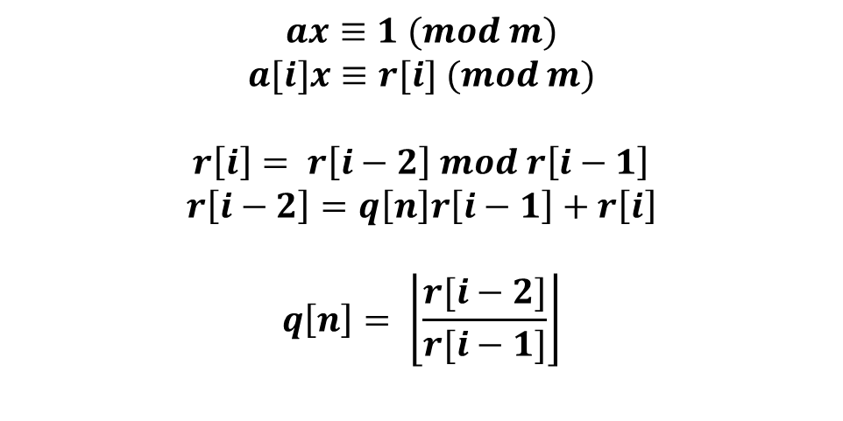
Need to tie the multiplicative inverse to Euclidean algorithm recurrence relation
$$ax≡1 (mod m)$$
$$a[i]x≡r[i] (mod m)$$
$$r\left[i\right]= r\left[i−2\right] mod r\left[i−1\right]$$
$$r\left[i−2\right]=q\left[n\right]r\left[i−1\right]+r\left[i\right]$$
$$q\left[n\right]= \left\lfloor \frac{r[i−2]}{r[i−1]}\right\rfloor$$
INSERT
VIDEO
HERE

Slide 36
Next we fold in our auxiliary congruence
INSERT
VIDEO
HERE

Slide 37
Next we fold in our auxiliary congruence
$$r\left[i\right]≡r\left[i−2\right]−q\left[n\right]r\left[i−1\right] (mod m)$$
INSERT
VIDEO
HERE

Slide 38
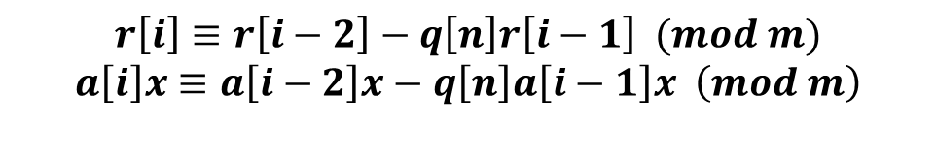
Next we fold in our auxiliary congruence
$$r\left[i\right]≡r\left[i−2\right]−q\left[n\right]r\left[i−1\right] (mod m)$$
$$a\left[i\right]x≡a\left[i−2\right]x−q\left[n\right]a\left[i−1\right]x \left(mod m\right)$$
INSERT
VIDEO
HERE

Slide 39
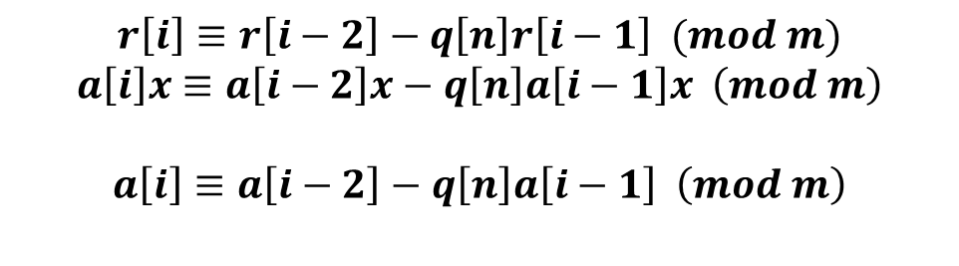
Next we fold in our auxiliary congruence
$$r\left[i\right]≡r\left[i−2\right]−q\left[n\right]r\left[i−1\right] (mod m)$$
$$a\left[i\right]x≡a\left[i−2\right]x−q\left[n\right]a\left[i−1\right]x \left(mod m\right)$$
$$a\left[i\right]≡a\left[i−2\right]−q\left[n\right]a\left[i−1\right] \left(mod m\right)$$
INSERT
VIDEO
HERE

Slide 40
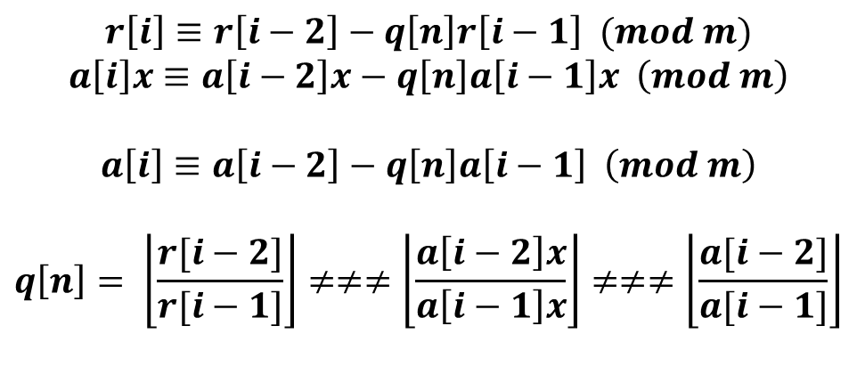
Next we fold in our auxiliary congruence
$$r\left[i\right]≡r\left[i−2\right]−q\left[n\right]r\left[i−1\right] (mod m)$$
$$a\left[i\right]x≡a\left[i−2\right]x−q\left[n\right]a\left[i−1\right]x \left(mod m\right)$$
$$a\left[i\right]≡a\left[i−2\right]−q\left[n\right]a\left[i−1\right] \left(mod m\right)$$
$$q\left[n\right]= \left\lfloor \frac{r[i−2]}{r[i−1]}\right\rfloor ≠≠≠\left\lfloor \frac{a\left[i−2\right]x}{a\left[i−1\right]x}\right\rfloor ≠≠≠\left\lfloor \frac{a[i−2]}{a[i−1]}\right\rfloor$$
INSERT
VIDEO
HERE

Slide 41
The key elements all in one place
INSERT
VIDEO
HERE

Slide 42
The key elements all in one place
$$r\left[0\right]=m;r\left[1\right]=x$$
INSERT
VIDEO
HERE

Slide 43

The key elements all in one place
$$r\left[0\right]=m;r\left[1\right]=x$$
$$a\left[0\right]x≡r\left[0\right]≡m \left(mod m\right)⇒a\left[0\right]=0$$
INSERT
VIDEO
HERE

Slide 44
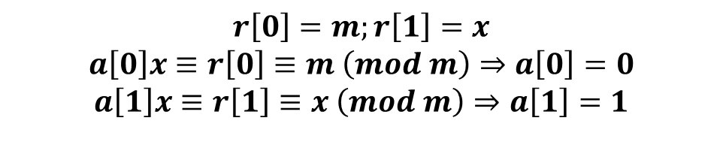
The key elements all in one place
$$r\left[0\right]=m;r\left[1\right]=x$$
$$a\left[0\right]x≡r\left[0\right]≡m \left(mod m\right)⇒a\left[0\right]=0$$
$$a\left[1\right]x≡r\left[1\right]≡x \left(mod m\right)⇒a\left[1\right]=1$$
INSERT
VIDEO
HERE

Slide 45
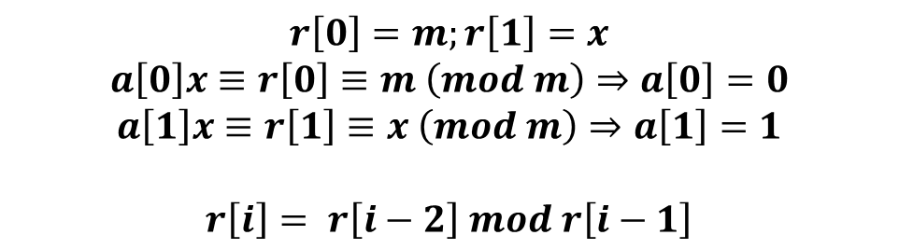
The key elements all in one place
$$r\left[0\right]=m;r\left[1\right]=x$$
$$a\left[0\right]x≡r\left[0\right]≡m \left(mod m\right)⇒a\left[0\right]=0$$
$$a\left[1\right]x≡r\left[1\right]≡x \left(mod m\right)⇒a\left[1\right]=1$$
$$r\left[i\right]= r\left[i−2\right] mod r\left[i−1\right]$$
INSERT
VIDEO
HERE

Slide 46
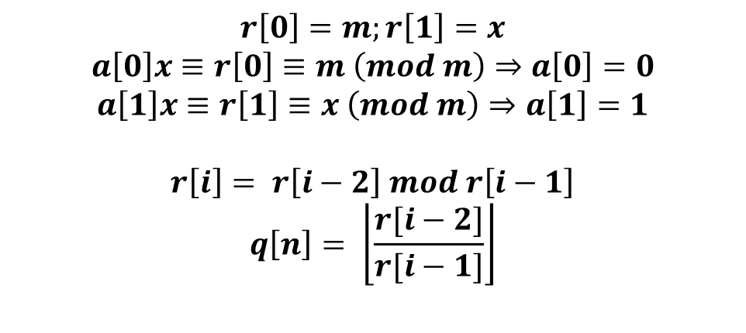
The key elements all in one place
$$r\left[0\right]=m;r\left[1\right]=x$$
$$a\left[0\right]x≡r\left[0\right]≡m \left(mod m\right)⇒a\left[0\right]=0$$
$$a\left[1\right]x≡r\left[1\right]≡x \left(mod m\right)⇒a\left[1\right]=1$$
$$r\left[i\right]= r\left[i−2\right] mod r\left[i−1\right]$$
$$q\left[n\right]= \left\lfloor \frac{r[i−2]}{r[i−1]}\right\rfloor$$
INSERT
VIDEO
HERE

Slide 47
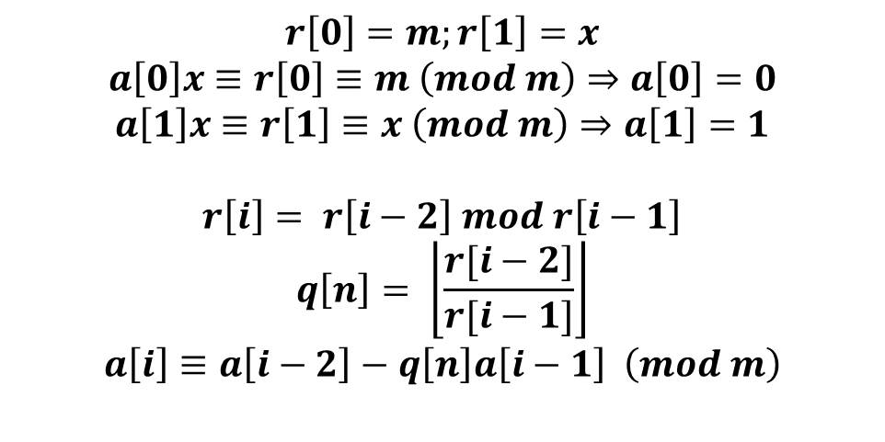
The key elements all in one place
$$r\left[0\right]=m;r\left[1\right]=x$$
$$a\left[0\right]x≡r\left[0\right]≡m \left(mod m\right)⇒a\left[0\right]=0$$
$$a\left[1\right]x≡r\left[1\right]≡x \left(mod m\right)⇒a\left[1\right]=1$$
$$r\left[i\right]= r\left[i−2\right] mod r\left[i−1\right]$$
$$q\left[n\right]= \left\lfloor \frac{r[i−2]}{r[i−1]}\right\rfloor$$
$$a\left[i\right]≡a\left[i−2\right]−q\left[n\right]a\left[i−1\right] \left(mod m\right)$$
INSERT
VIDEO
HERE

Slide 48
A quick example we already know the answer to: 7⁻¹ (mod 11)
INSERT
VIDEO
HERE

Slide 49
A quick example we already know the answer to: 7⁻¹ (mod 11)
i r[i] q[i] a[i]
0 11 -- 0
1 7 -- 1
2 4 1 10 ≡ 0 – 1· 1 (mod 11)
3 3 1 2 ≡ 1 – 1·10 (mod 11)
4 1 1 8 ≡ 10 – 1· 2 (mod 11)
INSERT
VIDEO
HERE

Slide 50
An example that is a bit more involved 2000⁻¹ (mod 2017)
I r[i] q[i] a[i]
0 2017 -- 0
1 2000 -- 1
2 17 1 2016
3 11 117 118
4 6 1 1898
5 5 1 237
6 1 1 1661
INSERT
VIDEO
HERE

Slide 51
An example that is a bit more involved 2000⁻¹ (mod 2017)
I r[i] q[i] a[i]
0 2017 -- 0
1 2000 -- 1
2 17 1 2016
3 11 117 118
4 6 1 1898
5 5 1 237
6 1 1 1661
INSERT
VIDEO
HERE

Slide 52
An example that is a bit more involved shows the usefulness of negative residues
INSERT
VIDEO
HERE

Slide 53
An example that is a bit more involved shows the usefulness of negative residues
i r[i] q[i] a[i]
0 2017 -- 0
1 2000 -- 1
2 17 1 -1
3 11 117 118
4 6 1 -119
5 5 1 237
6 1 1 -356 ≡ 1661 (mod 2017)
INSERT
VIDEO
HERE

Slide 54
No multiplicative inverse exists if the residue reaches 0 without becoming 1
INSERT
VIDEO
HERE

Slide 55
No multiplicative inverse exists if the residue reaches 0 without becoming 1
i r[i] q[i] a[i]
0 30 -- 0
1 22 -- 1
2 8 2 -1
3 6 2 3
4 2 1 -4
5 0 1 15
INSERT
VIDEO
HERE

Slide 56
What is 14019⁻¹ (mod 1247290)?
INSERT
VIDEO
HERE

Slide 57
What is 14019⁻¹ (mod 1247290)?
i r[i] q[i] a[i]
0 1247290 -- 0
1 14019 -- 1
2 13618 88 -88
3 401 1 89
4 385 33 -3025
5 16 1 3114
6 1 24 -77761 ≡ 1169529
INSERT
VIDEO
HERE

Slide 58
In review…
INSERT
VIDEO
HERE

Slide 59
In review…
Extended Euclidean algorithm answers many Q’s
INSERT
VIDEO
HERE

Slide 60
In review…
Extended Euclidean algorithm answers many Q’s
Streamlined version adequate to our needs
INSERT
VIDEO
HERE

Slide 61
In review…
Extended Euclidean algorithm answers many Q’s
Streamlined version adequate to our needs
Does a multiplicative inverse exist and what is it?
INSERT
VIDEO
HERE

Slide 62
In review…
Extended Euclidean algorithm answers many Q’s
Streamlined version adequate to our needs
Does a multiplicative inverse exist and what is it?
Residue = 1, inverse exists and we’ve identified it
INSERT
VIDEO
HERE

Slide 63
In review…
Extended Euclidean algorithm answers many Q’s
Streamlined version adequate to our needs
Does a multiplicative inverse exist and what is it?
Residue = 1, inverse exists and we’ve identified it
Otherwise, does not exist
INSERT
VIDEO
HERE

